Slide 1
Significance of Draft system & Performance of Economizer
Engineer Sher Khan Khoso
Chief Engineer
Matiari Sugar Mills Ltd.

Slide 2
INTRODUCTION
Boiler unit has a significant requirement of sufficient quantity of air for complete combustion & exhausting combustion products to the atmosphere after they have given their energy content at the required region.
The term Draft defined as ‘differential in pressure’ the difference between the atmospheric pressure & the pressure in the interior of flue gases (boiler furnace, vaporizing bank, dust collector inlet, heat exchangers & stack). It is expressed in inches of water (in water column)
In this paper a case study has been carried out on the distillery gas fired boiler of our sister concern. Paper briefly explain draft, draft analysis, draft control and its effects.

Slide 3
Classification of Boiler Draft
Boiler Draft
Natural Draft
Artificial Draft
Steam jet Draft
Mechanical Draft
Forced Draft
Induced Draft
Balanced Draft

Slide 4
Boiler Draft Control
Draft is one of the most critical aspects in any boiler system.
The boiler furnaces operated too much negative draft can cause a flame to be pulled off the burner head, draft too much air through the furnace, flue gas condensation, CO formation and soot formation.
Too much positive draft can create excessive heat at the head , cause premature failure & lost in thermal energy from the boiler.
Better Draft control can help to reduce overall boiler losses, reduce nitrogen oxide Nox, & reduce environment hazards.

Slide 5
Benefits of Balanced Boiler Draft
Artificial balanced draft is Combination of forced draft (F.D) and induced draft (I.D).
The balanced draft helps to ensure that there is a consistent flow of air into the furnace, which helps to maintain a stable combustion & temperature..
To maintain velocity of flue gases to get better heat transfer coefficient in the boiler & reduce overall pressure drop of flue gases.
Balanced boiler draft more economical, safe & better control.

Slide 6
Boiler Draft Analysis
Pressure drop calculation along the gas path is complex, it’s a function of the rate of flow, cross sections, changes of direction & length of various sections.
Bernoulli equation basically used to calculate pressure drop across boiler ducts and flues.
Pressure drop in tabular through flues and stack

Slide 7
Case Study
A case study has been carried out on the distillery gas fired boiler of our sister concern while increasing the heating surface and passes of its economizer.
Boiler capacity = 20 TPH
Bio gas & Natural gas fired boiler
Working pressure & temp = 24 bar & 340⁰C
Stack temperature = 220⁰C
Intend to capture the maximum energy from boiler flue gases, increasing heating surface & passes of present economizer,
Target is to bring down the stack temperature in range of 160-170 ºC.

Slide 8
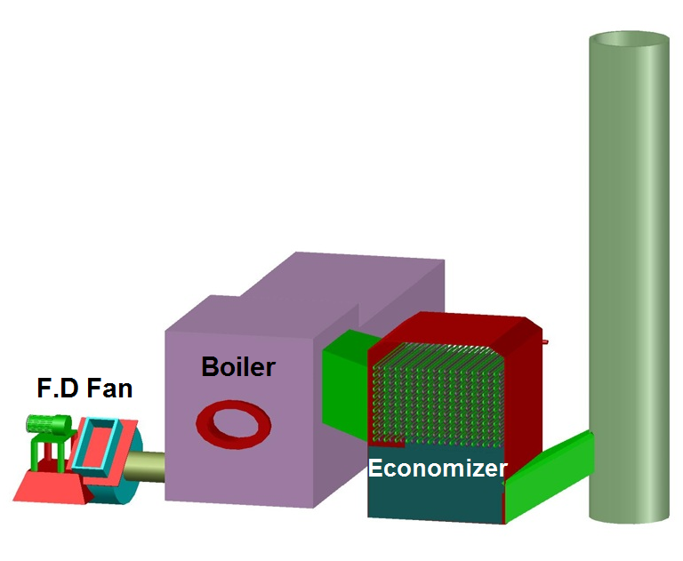
Matol Distillery Boiler Diagram

Slide 9
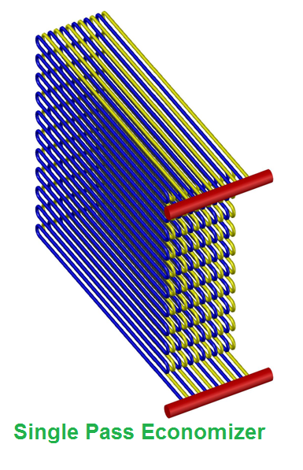
Existing Specification of Economizer
Coil length = 25m
No . Of coils = 12
Diameter of tube (mm) = 50.1
H.S of economizer = 67m²
Rise in feed water temp = 20⁰C
Stack temperature = 220⁰C
Single pass as shown in picture

Slide 10
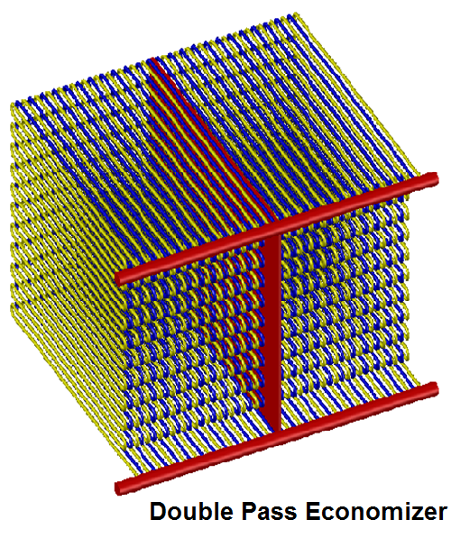
Case 1: specification of Economizer
Coil length = 55 m
No . Of coils = 48
Diameter of tube (mm) = 31.8
H.S of economizer = 263 m²
Rise in feed water temp = 47⁰C
Stack temperature = 140⁰C
Double pass as shown in picture

Slide 11
Interruptions in Boiler Operation
Initially an interruption was observed in the boiler forced draft
Hindrance in flow of flue gases through stack.
Tripping of gas burner, failure of combustion .
Pressure drop of flue gases, furnace pressure goes on higher side.
Disturbance in proper air fuel ratio.
Condensation of flue gases due to acid dew point.
soot formation & Chocking in economizer.

Slide 12
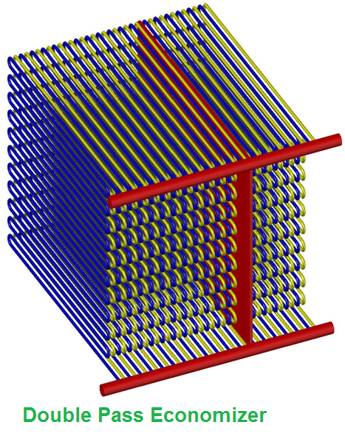
Case 2: Specification of Economizer
Coil length = 55.5 m
No . Of coils = 36
Diameter of tube = 31.8
H.S of economizer = 200 m²
Rise in feed water temp = 42⁰C
Stack temperature = 170⁰C
Double pass as shown in picture

Slide 13
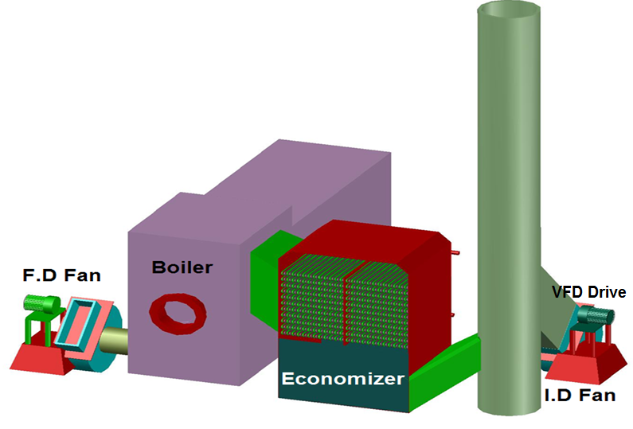
Boiler Diagram after modification

Slide 15
Smooth & Efficient Operation
After induction of I.D fan, boiler operate smoothly & efficiently no tripping of burner observed.
Proper burning of fuel and furnace temperature maintained throughout the boiler.
Velocity & pressure drop of flue gases maintained upto stack, no hindrance observed in path of flue gases.
Boiler balanced draft maintained no higher variation observed in draft.
No any condensation of flue gases observed at economizer.

Slide 16
Saving of Economizer
# | Description | Value of Exhaust Temp: ⁰C
 |  | 220 ºC | 170 ºC
01 | Steam generation kg/h | 17000 | 17000
02 | S/H steam enthalpy kcal/kg | 747.2 | 747.2
03 | Feed water enthalpy kcal/kg | 98 | 98
04 | Total losses % | 14.0 | 11.07
05 | Boiler efficiency % | 86.0 | 88.93
06 | Bio gas is main fuel to generate steam approximate 98% steam generated , remaining from Natural gas
07 | Natural gas consumed m³/h | 86 | 56
08 | Natural gas saved/day | 30×24= 720 m³/day

Slide 17
Pay back of Economizer
# | Description | Cost Rs.
01 | Cost of natural gas/m³ | 45
02 | Cost of natural gas saved /day | 45 × 720= 32400
03 | Cost of economizer material , Ducts, headers | 5.0 million
04 | Cost of economizer design, fabrication & erection | 1.5 million
05 | Total cost | 6.5 million
06 | Pay back period | 200 days

Slide 18
Conclusion
Auto draft control system is essential for proper & efficient operation of boiler.
Boiler engineer should ensure their operators are professionally trained on furnace draft control.
Proper analysis essential before induction of heat exchangers in boilers to maintain proper draft of boiler.
Maintaining an appropriate draft is a sign of efficient and safe operation of boiler.

Slide 19
THANK YOU

